Slide 1


Analysis Product Based On Behavior Seller and Customer
Python Course - Sekolah Data Pacmann
pacmann.io
© 2022 – Pacmann AI

Slide 2
Outline
Introduction
Description Data
Objective Question
Data Wrangling
Result Analysis
Conclution
Future Research
Link Full Anlysis and Code

Slide 3
Introduction
Notes:
Transisi antar outline

Slide 4
Introduction:
a marketplace company in the Nation Brazil sell a few product and each regions have different behavior from seller and customer. That difference started from score review product most preferred or not by customer. For we want to know behavior must analysis a few factor to improve income company in the future.

Slide 5
Description Data
Notes:
Transisi antar outline

Slide 6
Description Data :
File name is olist.db
Data name for analysis :
- olist_order_reviews_dataset.
- olist_order_dataset.
- olist_order_items_dataset.
- olist_products_dataset.
- product_category_name_translation.
- olist_sellers_dataset.
Select table for analysis from previous list data :
- Review Score - Freight value
- Order Status - Product Photos Qty
- Order Purchase Timestamp - Seller City
- Deliver Purchase Timestamp - Seller State
- Price

Slide 7
Objective Question
Notes:
Transisi antar outline

Slide 8
Objective Question:
How many sum of sold and profit obtained by seller?
- How many sum of sold and profit in last 3 years and annually?
- How many proportion sum of sold and profit in last 3 years?
- Which products that obtained sum of sold and profit the highest and the lowest in last 3 years and annually?
Which is product that a few interest by customer ?
- How proportion score review and which regions that a most obtained score review?
- How proportion photos sum of published and which regions that a most obtained published photos?
- How sum of status order on the product and which is product that obtain sum of canceled order by customer?
How are condition sellers on Marketplace?
- When purchase happen often?
- how many days trend delivery recived by customer and which regions enter in this trend ?
- Which regions and state include slowely delivery to customer?
- How proportion between product recived <=14 days and >14 days, and which product enter in this?
- How many delivery most expensive and cheapest on the product? and which product enter in most expensive and cheapest?

Slide 9
Data Wrangling
Notes:
Transisi antar outline

Slide 10
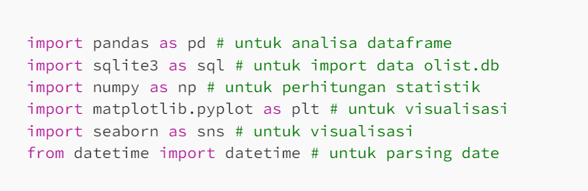
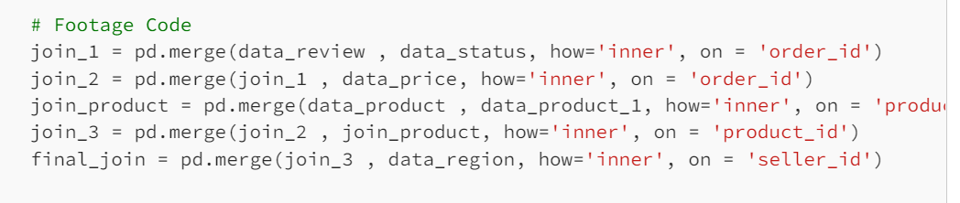
Data Wrangling :
Data Cleaning
1. Join data
Previously we obtain 37 table after join data and then we drop a few table that not used, after than we obtain 9 table for anlysis.

Slide 11
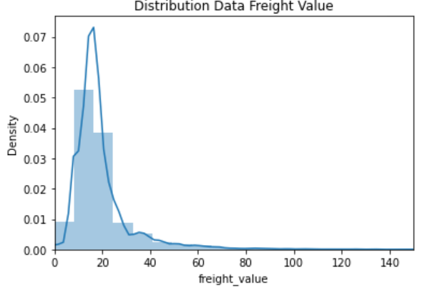
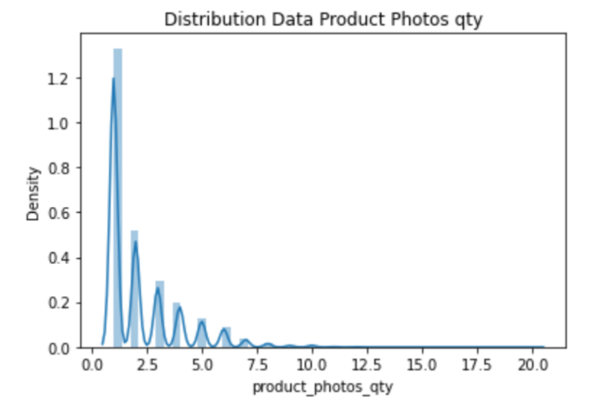
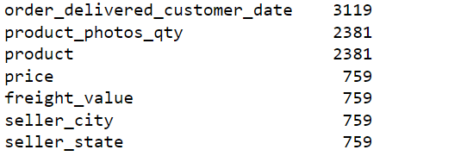
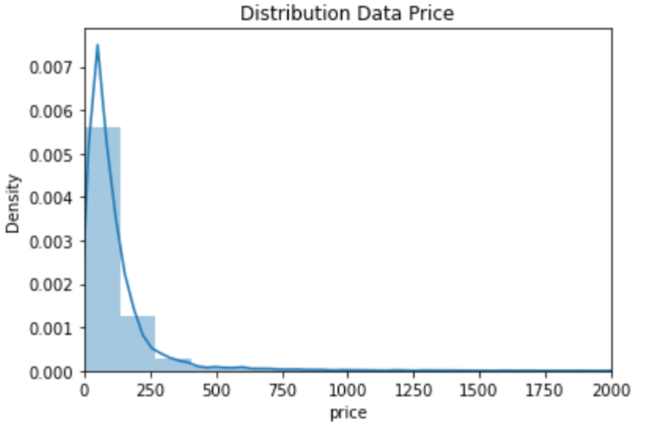
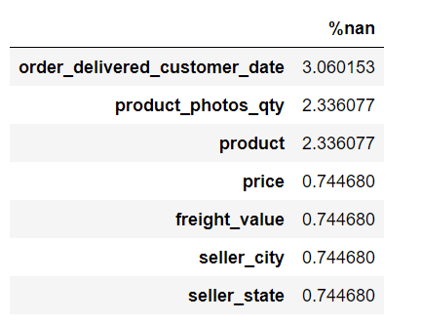
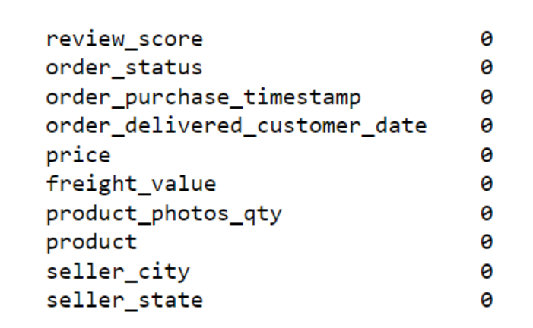
Data Wrangling :
Distribution Data Numerik
2. Handling Missing Nulls Values
Output Missing Nulls Values
Output After Cleaning
Missing Nulls Values

Slide 12
Data Wrangling :
3. Handling Duplicate Values
Code :
data_analisa.duplicated().count()
data_analisa.drop_duplicates(keep='first',inplace=True, ignore_index=True)
We obtain duplicate data is 101891 and then we drop duplicate and take first
duplicate data
4. Handling Outlier
We want check data outlier numerik type data with boxplot :

Slide 13
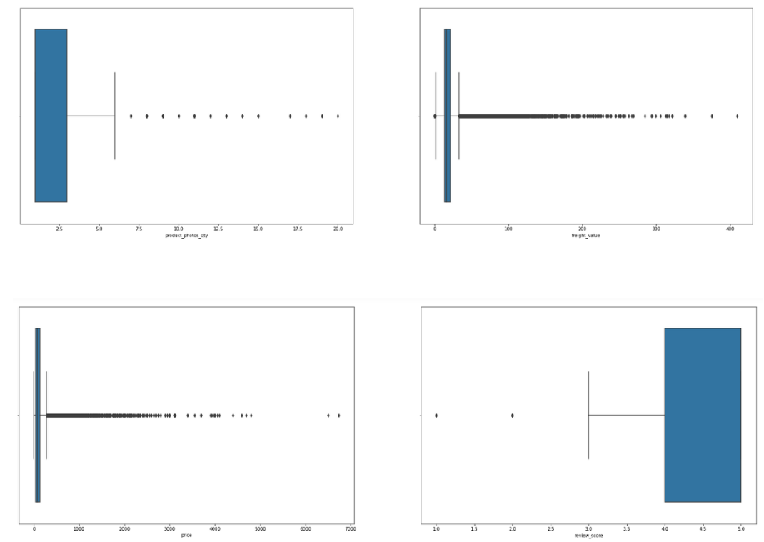
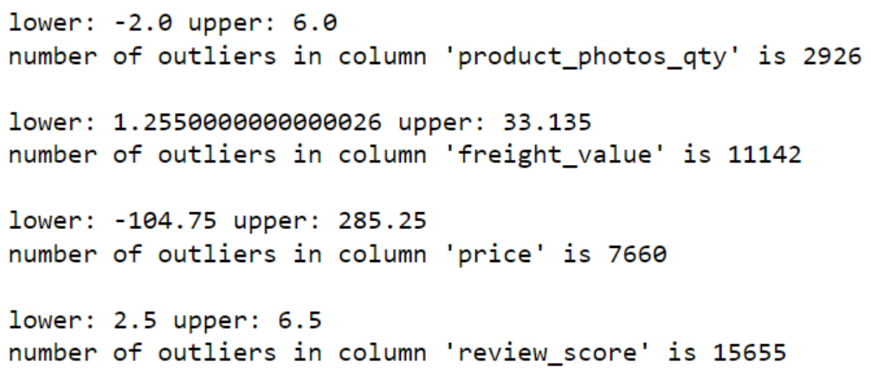
Data Wrangling :
Result outlier from boxplot :
Result outlier with IQR Method :

Slide 14
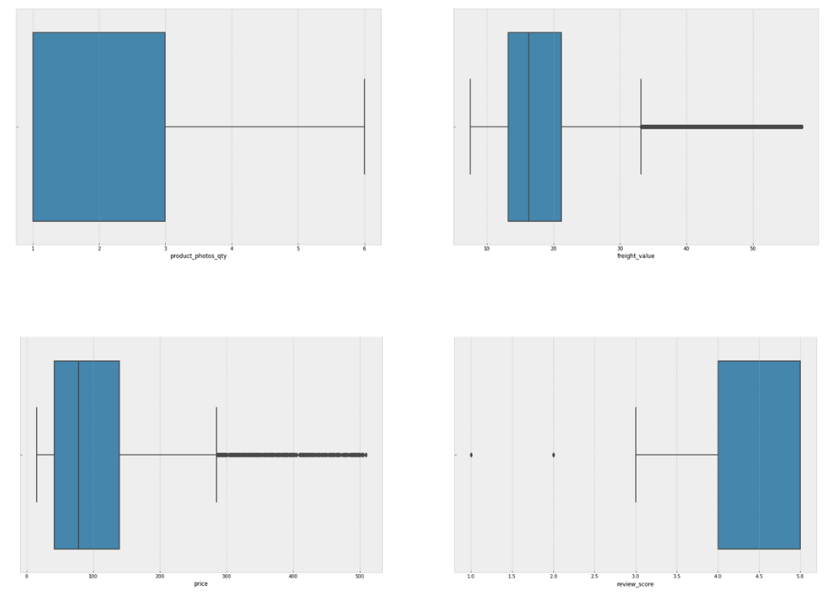
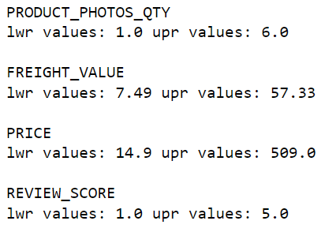
Data Wrangling :
We want drop outlier with capping method :
In this method we make lower limit 3% and higher limit 97 % for data values .
Result boxplot after drop data outlier
We will drop values :

Slide 15
Data Wrangling :
B. Data Manipulation
1. Manipulation Date
We want make parsing date to breakdown date time as a hour, days, months, and years. Before we make it, change data type from object to datetime to data “'order_purchase_timestamp and order_delivered_customer_date”
Sample code :
data_analisa['order_purchase_timestamp’] = data_analisa['order_purchase_timestamp'].astype('datetime64[ns]’)
After parsing data we found 0 values in “day_week_deliver and day_week_purchase” the values must 7 (Sunday) and change this values.
Also in new table for know range days delivery to customer, we found 0 values and we change to 0.5 values (it’s just absolute calculation and we consider 0.5 day).
After parsing data, data table add to 23 table.

Slide 16
Data Wrangling :
2. Manipulation Groupby
Analysis requires creating data groupby in order to know aggregation value in each category created. Some groupby needs a condition that states the deliverd and other conditions for the values to deliver match and there is no bias by unneeded conditions.

Slide 17
Result Analysis
Notes:
Transisi antar outline

Slide 18
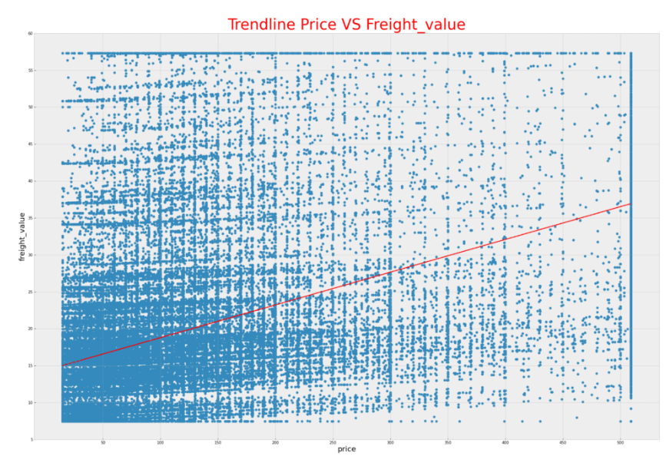
Result Analysis :
For your information in this PPT (Presentation just show result anlysis which already obtain, you can see full analysis in my link medium which I will put in the last slide)
Trendline :
We obtain trendline between price and
freight value shaped linier positif, that’s mean values will increase or decrease simultaneously.
Or formula : (Trendline : y=0.044336x+(14.357383))
X = price values

Slide 19
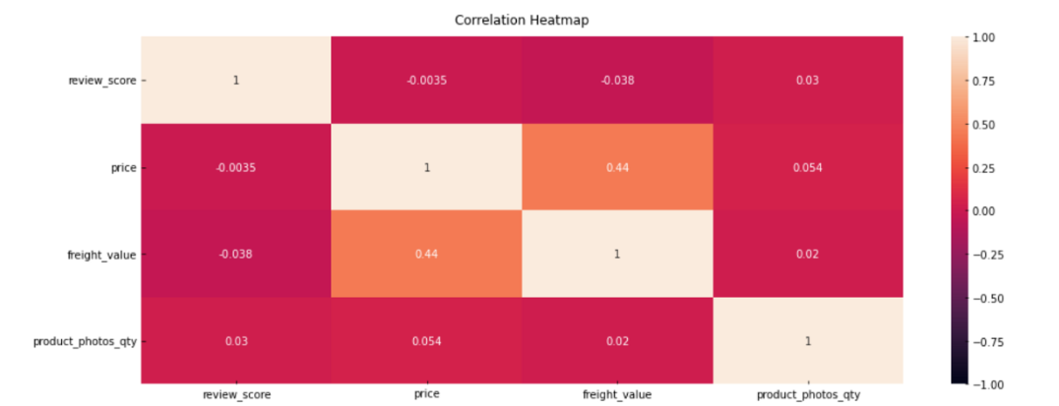
Result Analysis :
Correlation : the greatest correlation is in between price and freight_value (0.44 positif)

Slide 20
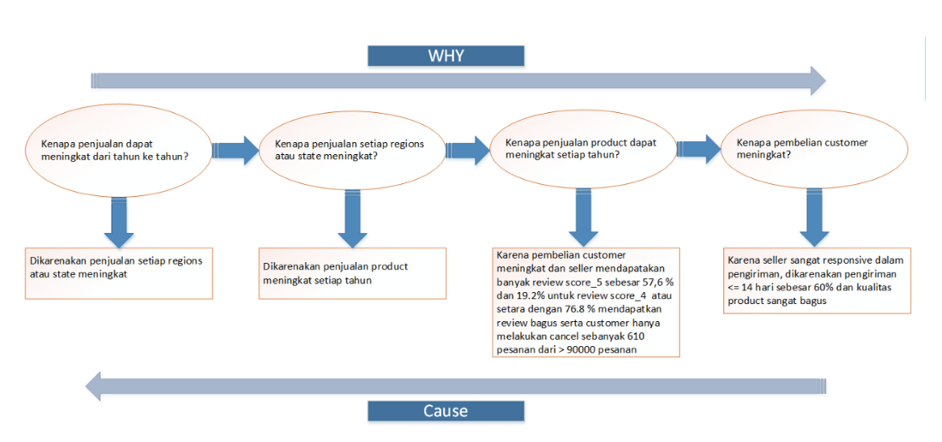
Root Cause :

Slide 21
Conclution
Notes:
Transisi antar outline

Slide 22
Conclution :
1. Profit increase significant, drastic increase in 2016 -2017 years as large as 99.31% .
2. In the 3 years the highest proportion profit and sum of sold in 2018 years as large as 54.9 % and 54.8 %.
3. The highest sold out in 3 last years is bed_bath_table product but profit the highest is health_beauty product, while the lowest is security_and_service product.
4. The drastic increase in the bad_bath_table product in 2016 is not in the top 5 but immediately rose to 1st position in 2017–2018.
5. In the last 3 years of product fashion category occupying the bottom 5 rankings, this indicates a lack of interest in product fashion from customers.
6. The region with the highest income category is the highest income region as well.
7. The big 5 largest product is bed_bath_table product sold in the Ibitinga region, whereas health_beauty, sports_leisure, computer_accessories, and furniture_decor products are dominated by the Sao Paulo region.
8. The highest income is in the Sao Paulo region and State SP because a lot of the big category 5 products are there.
9. Total customer reviews are dominated with a score_5 of 57.6% and the most in Bed_bath_table products but need to be improved also because they include score_1 as well. The score_5 producing region and score_1 on that product is Ibitinga. Whereas health_beauty has score_5 and score_1 to the 2nd highest and is in the Sao Paulo region

Slide 23
Conclution :
10. Of the publication of the photo published, the publication of 1x affects the number of purchases and is dominated by what is now the highest product of product.
11. The sum of order that get canceled by customer the highest is Bed_bath_table product in Region Sao Paulo and State SP.
12. Behavior time of purchase from customer in at 16:00 pm, on Sunday, and in Agustus. The product include highest is Bed_bath_table and the region is Sao Paulo.
13. Behavior seller obtain trending delivery is 10 days, delivery <= 14 days as big as 60% and delivery > 14 days domination by product Bed_bath_table in the region Sao Paulo.
14. Product that have income the largest exist 3 product with delivery most expensive as big as 57.33 $ is furniture_decor, health_beauty, dan Bed_bath_table in the region Sao Paulo.
15. A trendline between price and freightghtvalue is a liner and a correlation of the data at 0.44 which means its value is directly proported.
16. The previous root cause product quality and the seller's treatment to customers are crucial to increasing corporate profits.

Slide 24
Future Research
Notes:
Transisi antar outline

Slide 25
Future Research :
From analysis and previous conclusions it is expected to focus on improving product bed_table and region Sao Paulo and state SP because of the high selling and yet the seller in the region is only bad enough than other product and regions. Product and the region get the review_score_1 the highest and longest delivery (>14 days), get most canceled by customer, and most expensive deliveries. Product fashion needs to improvement because of the lack of interest in the product. If you want to do a massive seller discount can do it at 4:00 p.m. on Sunday, and in August that is the most purchase behavior by customers.

Slide 26
Link Full Anlysis and Code :
Link for full code :
https://github.com/pompymandislian/Python_Analysis-Product-Based-On-Behavior-Seller-and-Customer
Link for Full Analysis in Medium:
https://medium.com/@mandispompy/analysis-product-based-on-behavior-seller-and-customer-e064f362b560

Slide 27
Thankyou! (^_^)
Notes:
Transisi antar outline

